Slide 1
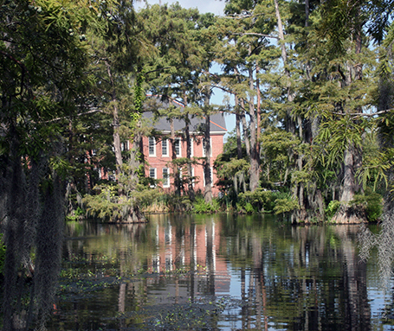
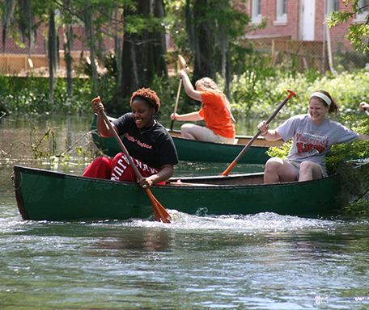
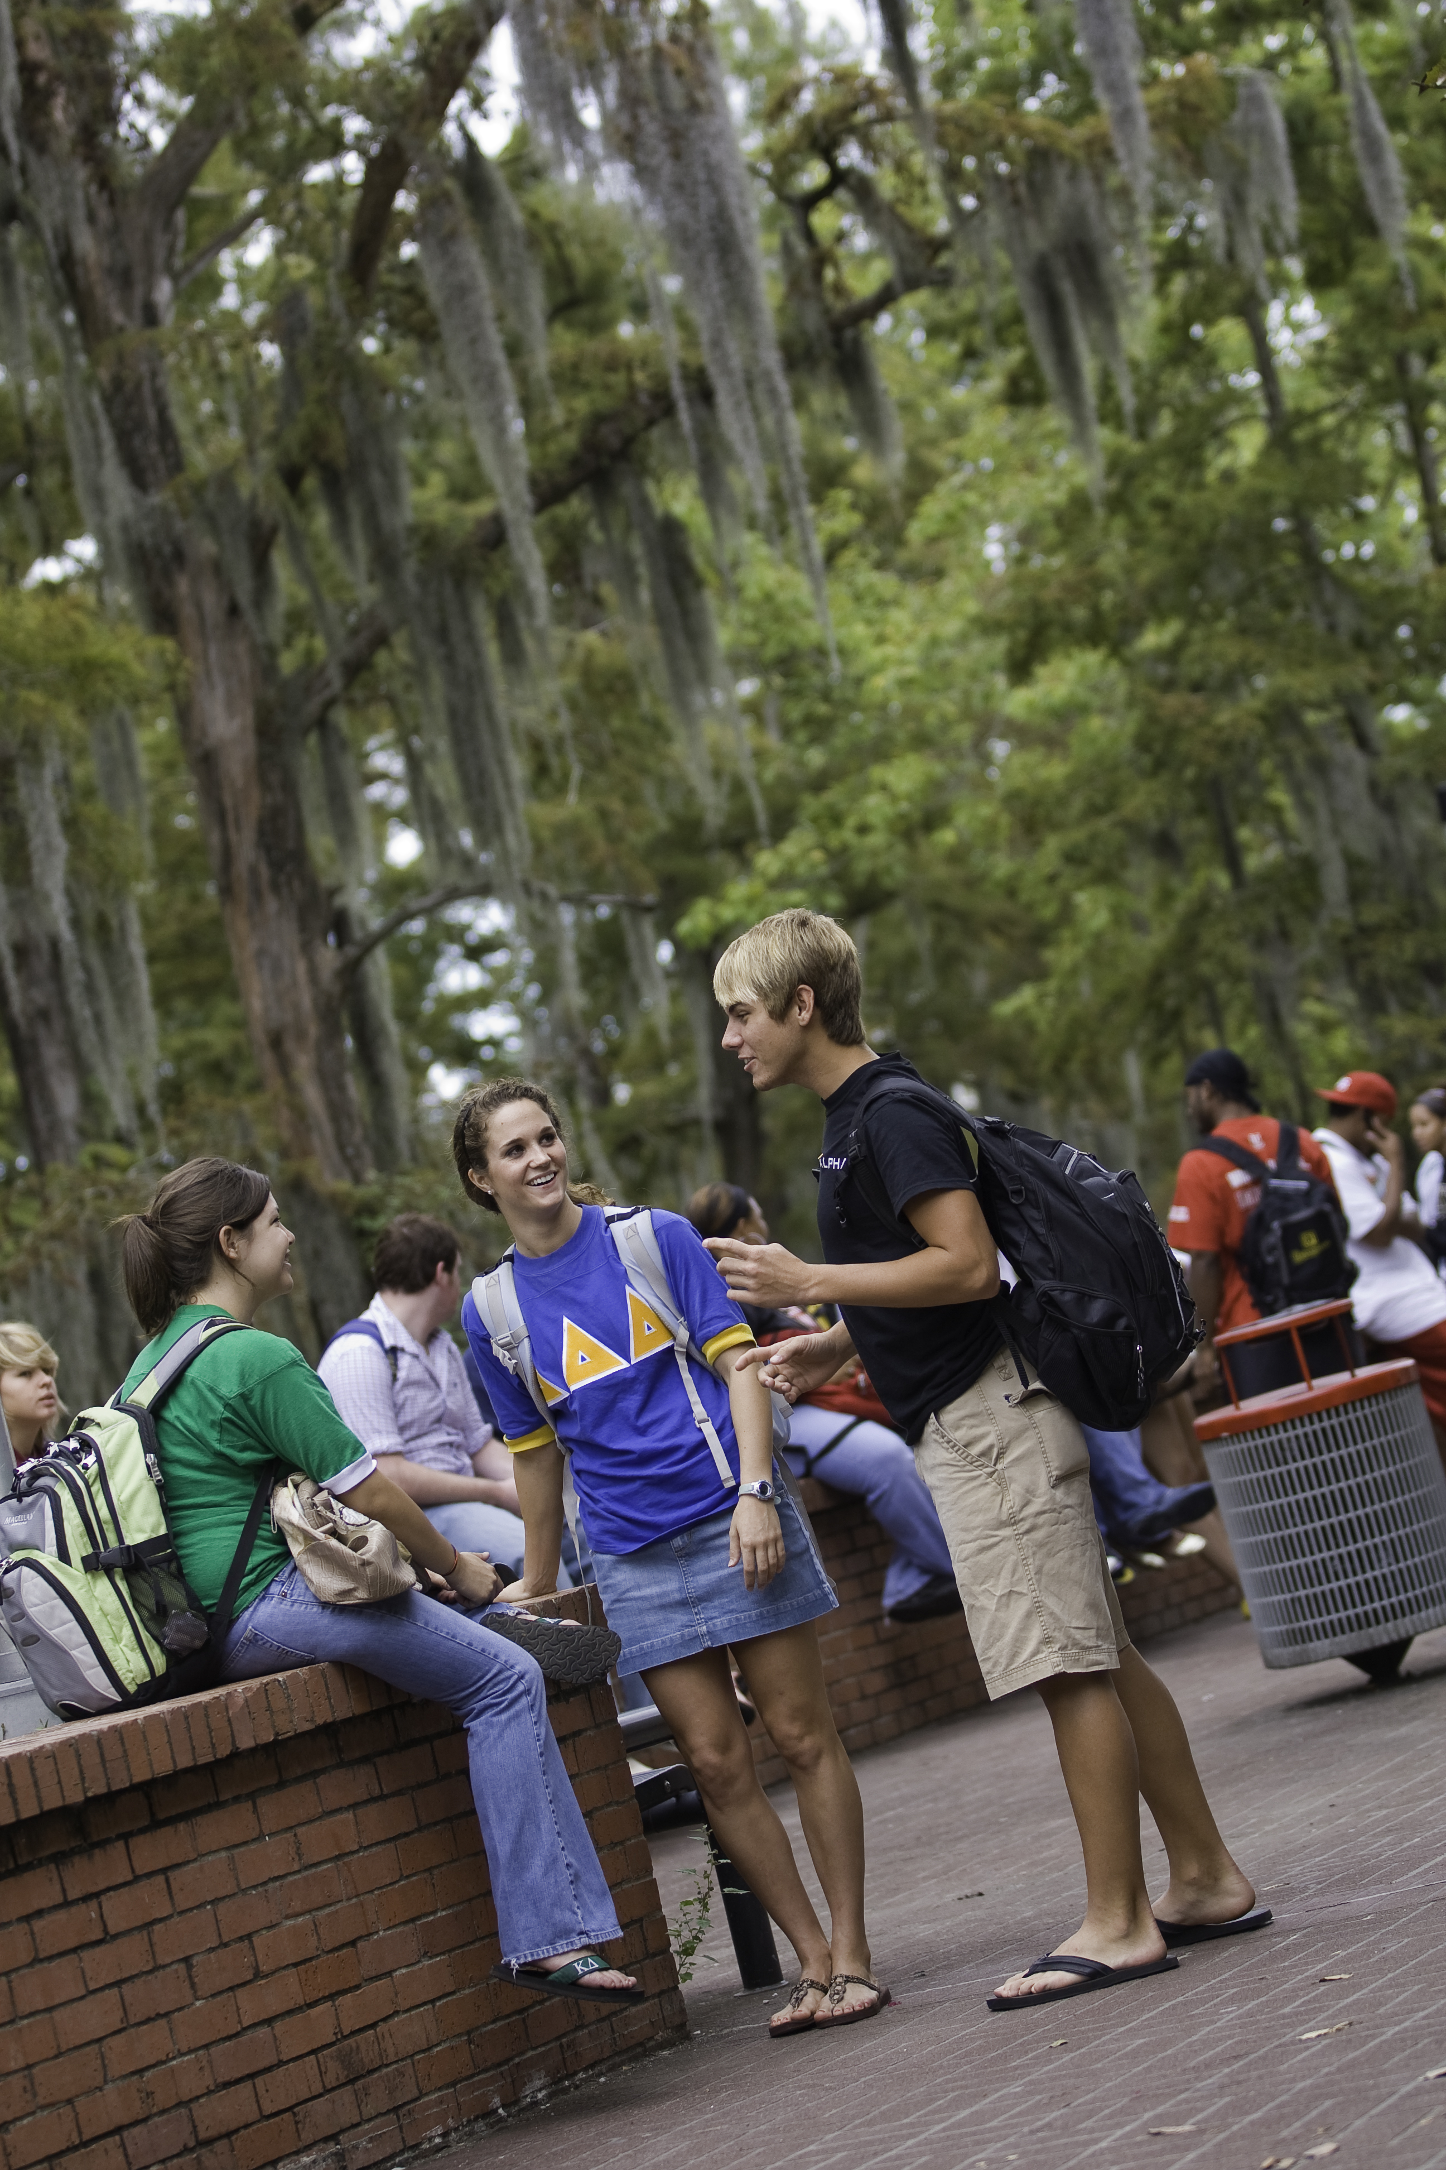
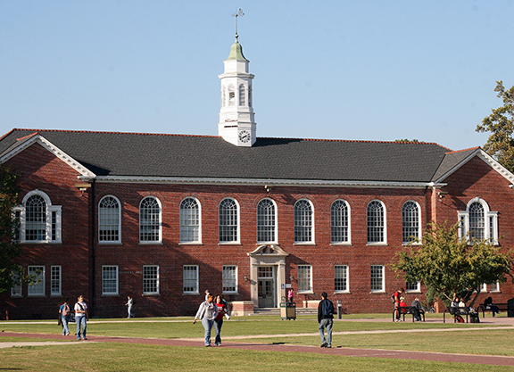
LONG DEPARTMENT NAMES GO HERE
Your Heading Your Subheading
Rit inullam evel ilibus volorup tassit as vent omni ratet de et ut ommo odit accullant essust exero volupta tectioribus sed magnam et od et que veror.
Research for a reason.
Notes:
This page is an opening page for long-length named departments that introduces topics. Please follow subtopic pages with the appropriate template.
The photos on this page may be replaced with photos that are more relevant to your presentation. Consistent space between your pictures, as well as your pictures being on an “invisible grid,” will make a more aethestically pleasing, cohesive design.
Research for a reason is one of our key branding messages.
You may replace “Research for a reason.” with any of the following key branding phrases:
This is our time, and we’re determined to make the most of it.
We have a gift of bringing people together.
We’re eager to share what we’re learning.
We teach the real meaning of joie de vivre.
Our Ragin’ Cajun spirit goes beyond athletics.

Slide 2
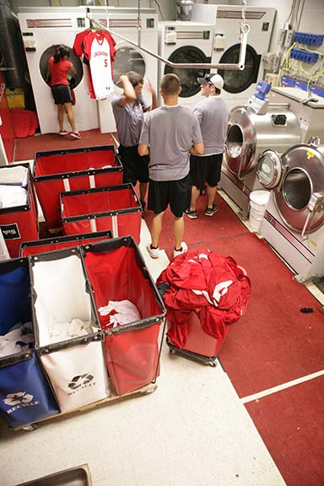
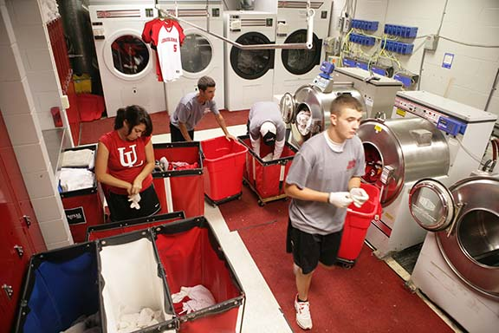
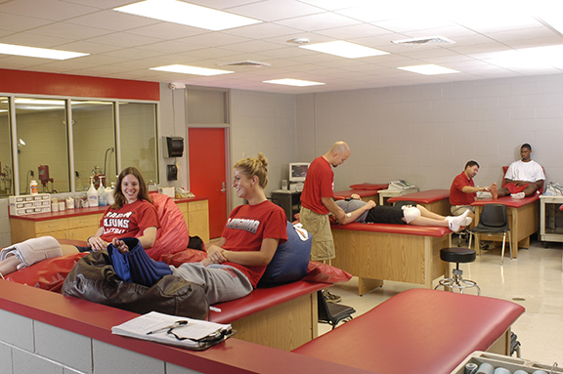
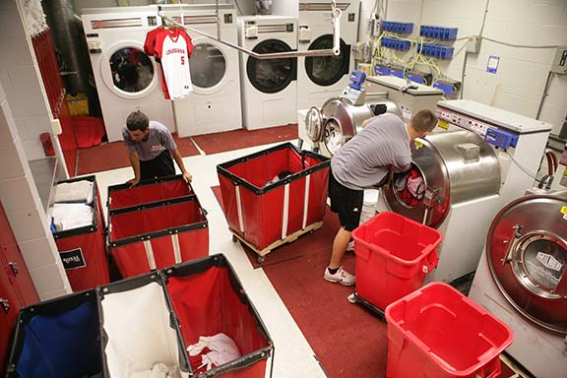
MEDIUM NAMES HERE
Your Heading Your Subheading
Rit inullam evel ilibus volorup tassit as vent omni ratet de et ut ommo odit accullant essust exero volupta tectioribus sed magnam et od et que veror.
Research for a reason.
Notes:
This page is an opening page for medium-length named departments that introduces topics. Please follow subtopic pages with the appropriate template.
The photos on this page may be replaced with photos that are more relevant to your presentation. Consistent space between your pictures, as well as your pictures being on an “invisible grid,” will make a more aethestically pleasing, cohesive design.
Research for a reason is one of our key branding messages.
You may replace “Research for a reason.” with any of the following key branding phrases:
This is our time, and we’re determined to make the most of it.
We have a gift of bringing people together.
We’re eager to share what we’re learning.
We teach the real meaning of joie de vivre.
Our Ragin’ Cajun spirit goes beyond athletics.

Slide 3
SHORT NAMES
Your Heading Your Subheading
Rit inullam evel ilibus volorup tassit as vent omni ratet de et ut ommo odit accullant essust exero volupta tectioribus sed magnam et od et que veror.
Research for a reason.
Notes:
This page is an opening page for short-length named departments that introduces topics. Please follow subtopic pages with the appropriate template.
The photos on this page may be replaced with photos that are more relevant to your presentation. Consistent space between your pictures, as well as your pictures being on an “invisible grid,” will make a more aethestically pleasing, cohesive design.
Research for a reason is one of our key branding messages.
You may replace “Research for a reason.” with any of the following key branding phrases:
This is our time, and we’re determined to make the most of it.
We have a gift of bringing people together.
We’re eager to share what we’re learning.
We teach the real meaning of joie de vivre.
Our Ragin’ Cajun spirit goes beyond athletics.

Slide 4
YOUR HEADING Your Subheading
This page should serve as the page used after you’ve used the page that specifies your department. Use the Department specification page as something of a chapter break. When you go into a new topic, use the Department specification page as a first page. Subsequent pages should be the template of this page. Note the difference at the top.
Notes:
This page is a subtopic page. It would follow one of the opening page. This page helps differentiate your main topic from subtopics. When introducing a new topic, please use an opening page template.
The photos on this page may be replaced with photos that are more relevant to your presentation. Consistent space between your pictures, as well as your pictures being on an “invisible grid,” will make a more aethestically pleasing, cohesive design.
Research for a reason is one of our key branding messages.
You may replace “Research for a reason.” with any of the following key branding phrases:
This is our time, and we’re determined to make the most of it.
We have a gift of bringing people together.
We’re eager to share what we’re learning.
We teach the real meaning of joie de vivre.
Our Ragin’ Cajun spirit goes beyond athletics.

